Slide 1
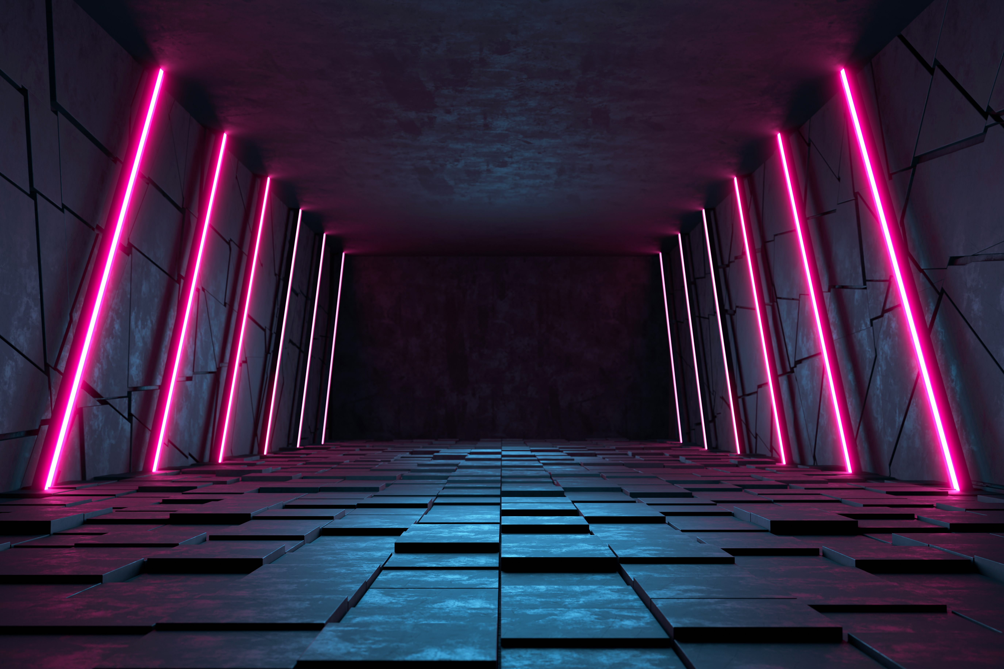
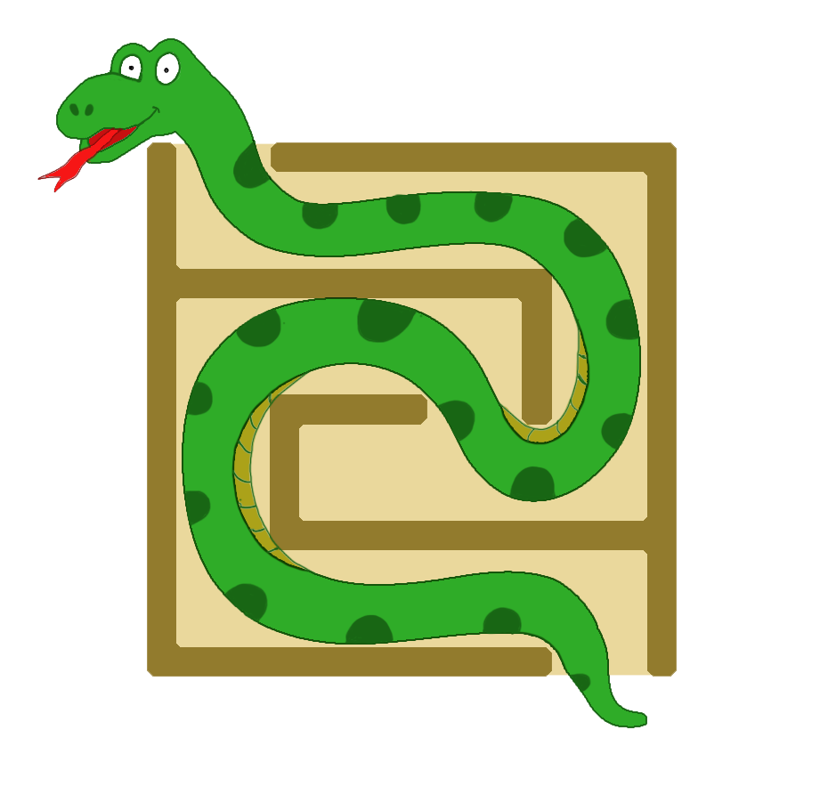
Welcome to our Maze Solver Application

Slide 2
pyamaze Module
class COLOR(Enum): This class is created to use the Tkinter colors easily.
class agent: The agents can be placed on the maze.
class textLabel: This class is to create Text Label to show different results on the window.
class maze: This is the main class to create maze.

Slide 3
class COLOR(Enum):
This class is created to use the Tkinter colors easily.
Each COLOR object has two color values.
The first two objects (dark and light) are for theme and the two color values represent the Canvas color and the Maze Line color respectively.
The rest of the colors are for Agents.
The first value is the color of the Agent and the second is the color of its footprint

Slide 4
class agent:
The agents can be placed on the maze.
They can represent the virtual object just to indicate the cell selected in Maze.
Or they can be the physical agents (like robots)
They can have two shapes (square or arrow)

Slide 5
class textLabel:
This class is to create Text Label to show different results on the window. def __init__(self, parentMaze, title, value): parentmaze--> The maze on which Label will be displayed. title------------> The title of the value to be displayed value----------> The value to be displayed

Slide 6
class maze:
This is the main class to create maze. def __init__(self, rows=10, cols=10):
Need to pass just the two arguments. The rest will be assigned automatically
rows--> No. of rows of the maze
cols--> No. of columns of the maze
maze_map--> Will be set to a Dicationary. Keys will be cells and values will be another dictionary with keys=['E','W','N','S'] for East West North South and values will be 0 or 1. 0 means that direction(EWNS) is blocked. 1 means that direction is open.
grid--> A list of all cells
path--> Shortest path from start(bottom right) to goal(by default top left) It will be a dictionary
_win,_cell_width,_canvas --> _win and )canvas are for Tkinter window and canvas _cell_width is cell width calculated automatically
_agents--> A list of aganets on the maze
markedCells--> Will be used to mark some particular cell during path trace by the agent.

Slide 7
class maze: Functions
def _Open_‘Direction’ (self, x, y): To remove the Wall of the cell in direction selected
def CreateMaze(self, x=1, y=1, pattern=None, loopPercent=0, saveMaze=False, loadMaze=None,theme: COLOR = COLOR.dark):
Function to create a Random Maze
pattern--> It can be 'v' for vertical or 'h' for horizontal
Just the visual look of the maze will be more vertical/horizontal
passages will be there.
loopPercent--> 0 means there will be just one path from start to goal (perfect maze)
Higher value means there will be multiple paths (loops)
Higher the value (max 100) more will be the loops
saveMaze--> To save the generated Maze as CSV file for future reference.
loadMaze--> Provide the CSV file to generate a desried maze
theme--> Dark or Light

Slide 8
class maze: Functions
def tracePath(self, d, kill=False, delay=300, showMarked=False):
A method to trace path by agent You can provide more than one agent/path details
def run(self): Finally, to run the Tkinter Main Loop

Slide 9
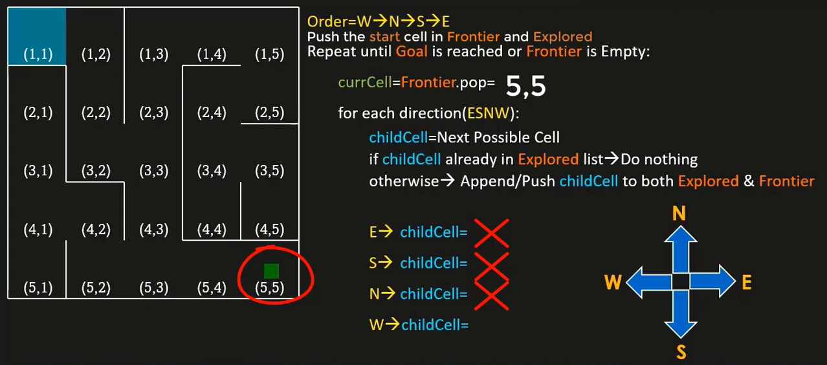
Depth First Search
5,4

Slide 10
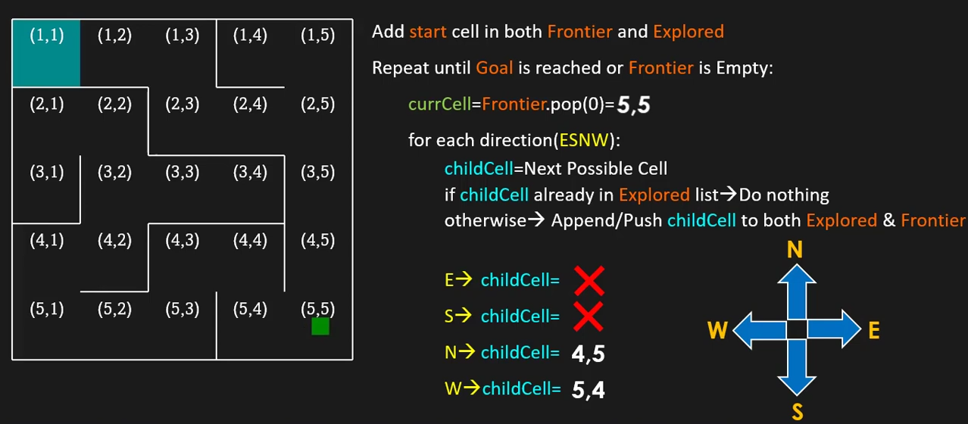
Breadth First Search

Slide 11
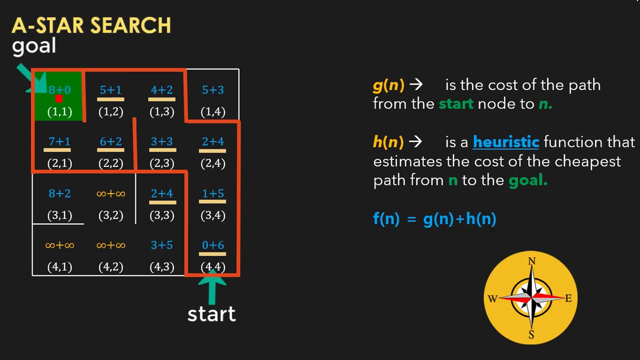

Slide 12
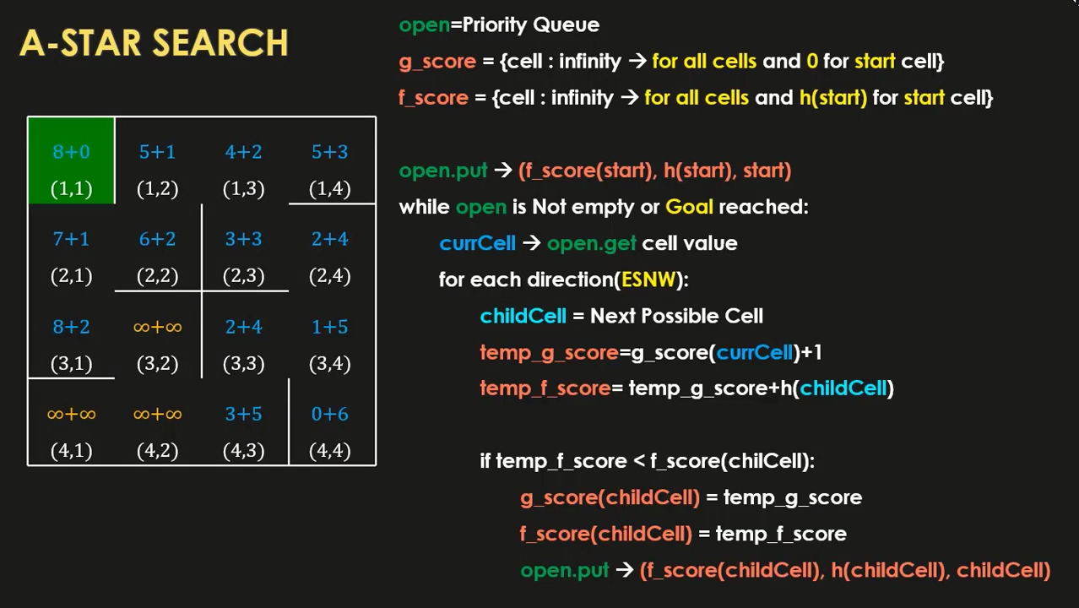

Slide 13
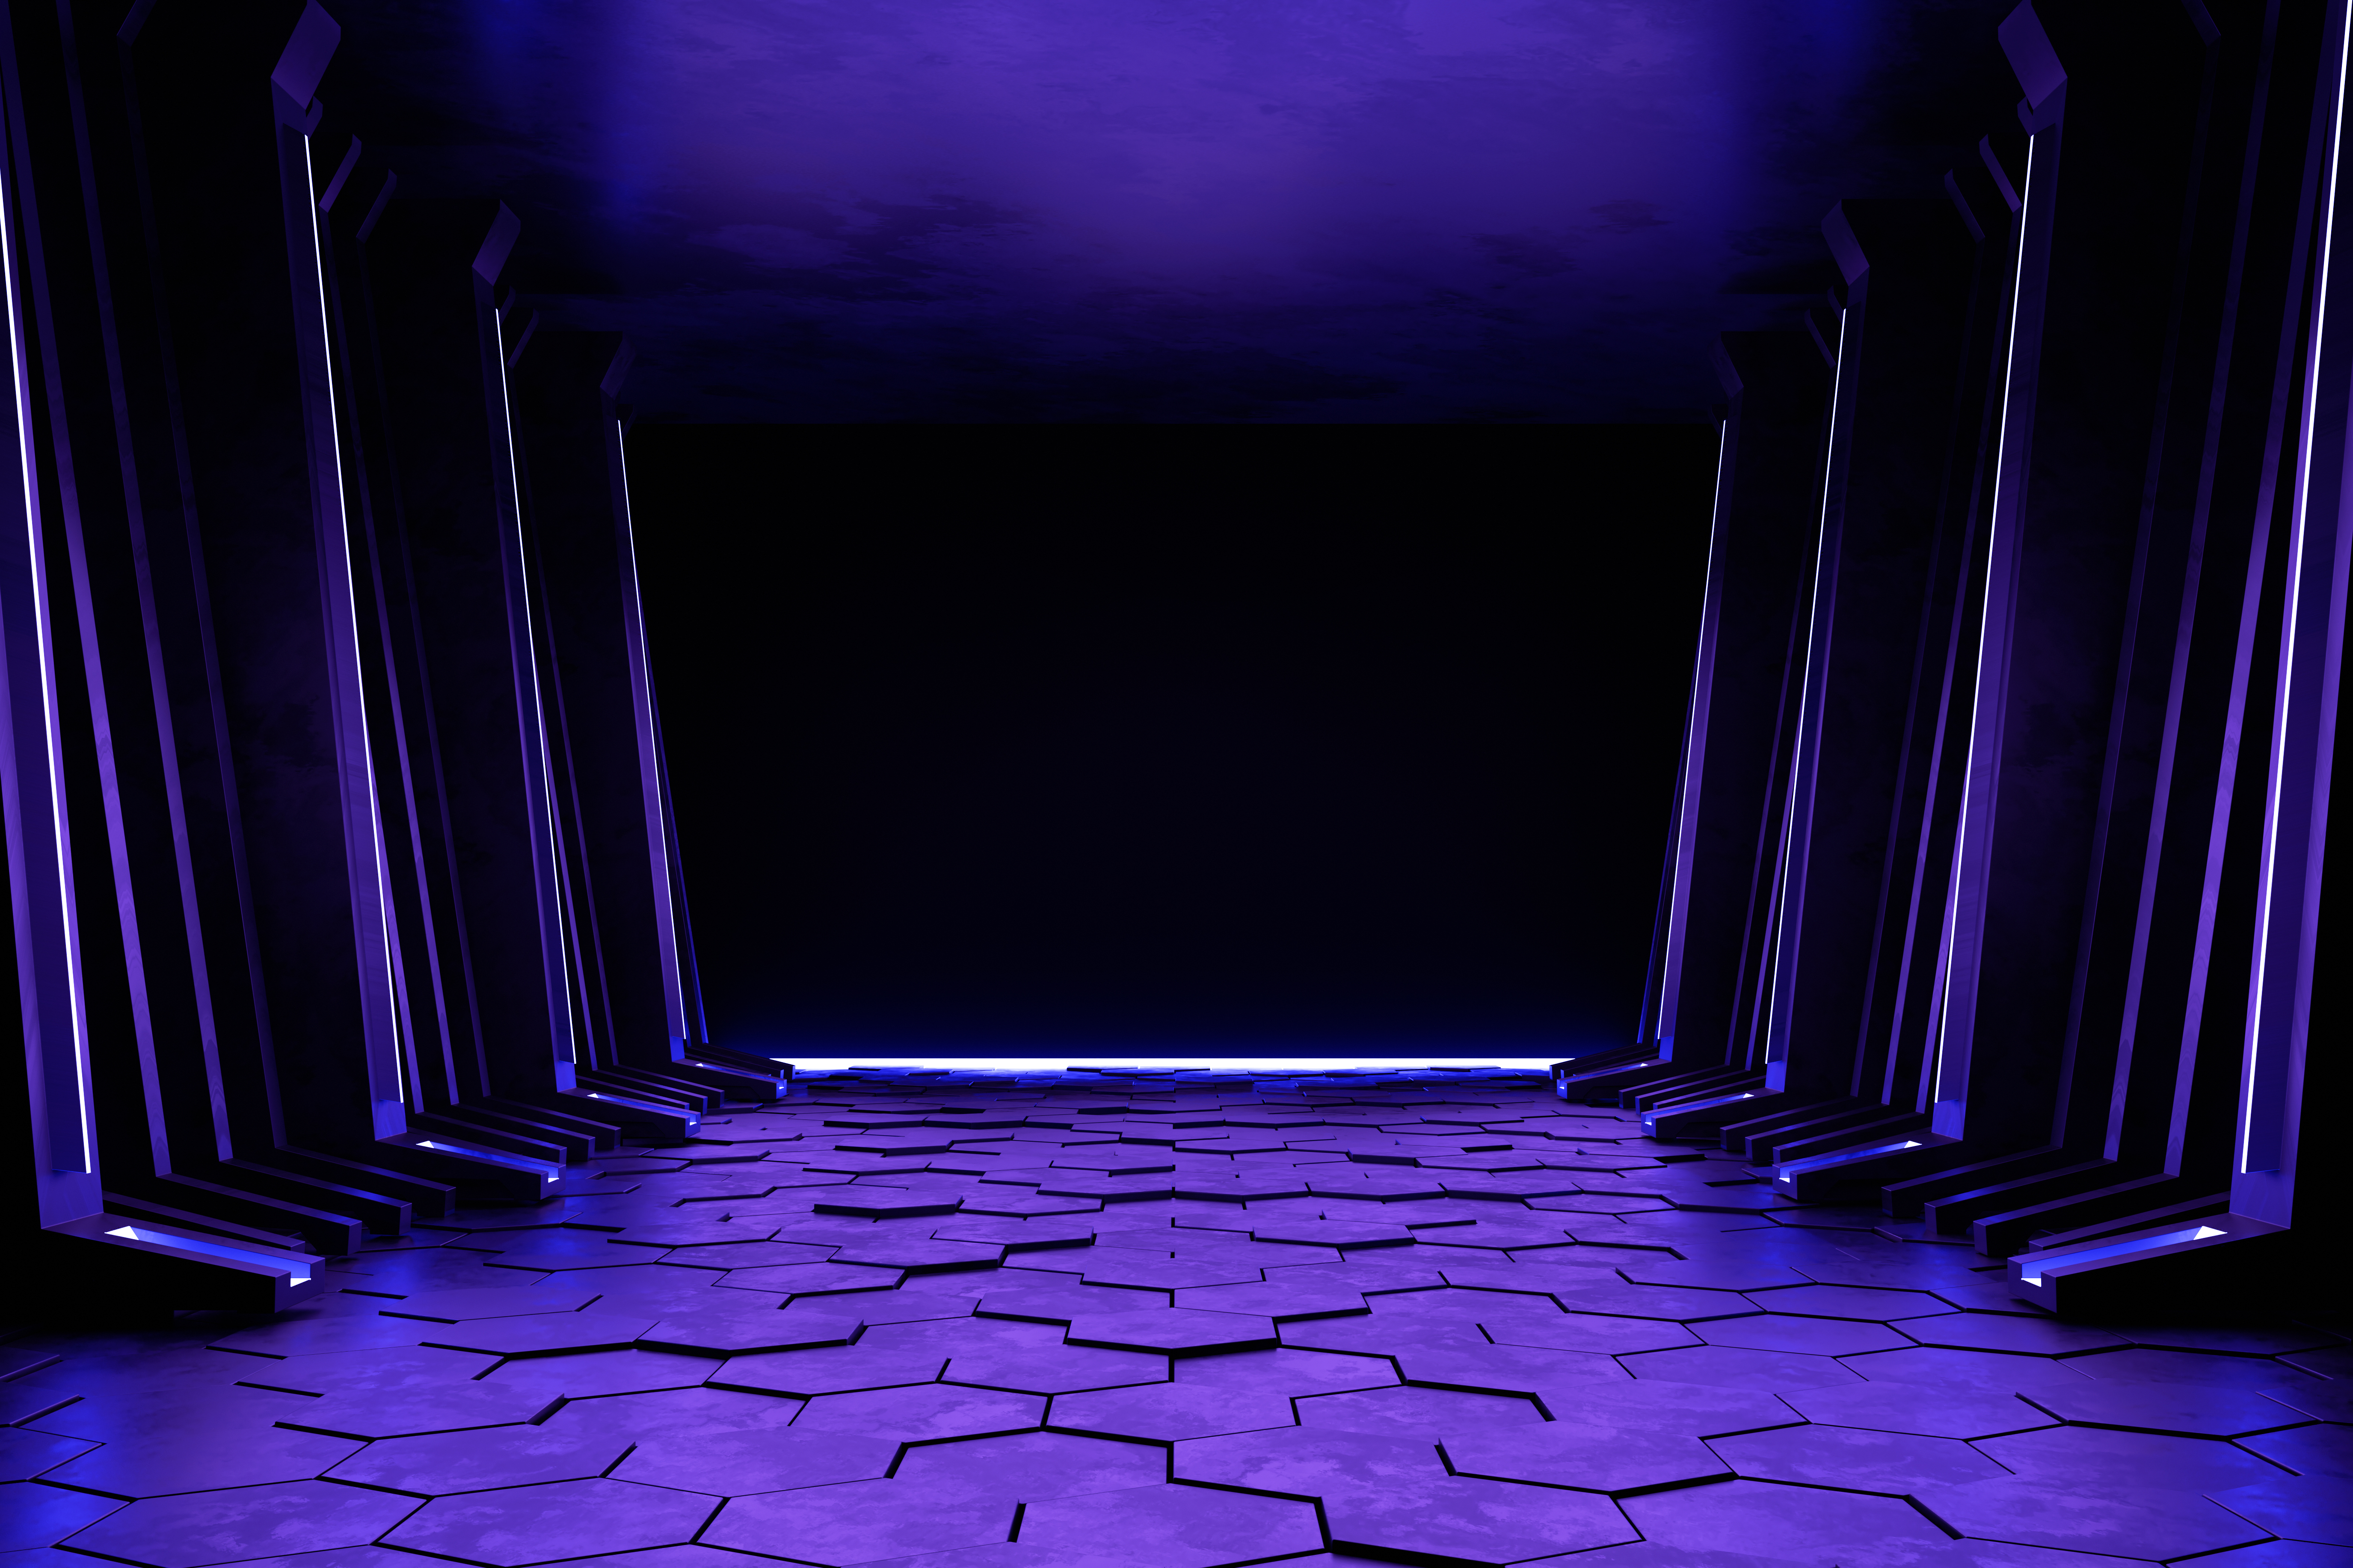
Thank You

